Slide 1
UNIT – III
ANALOG MULTIPLERS

Slide 2
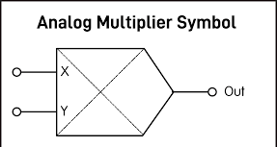
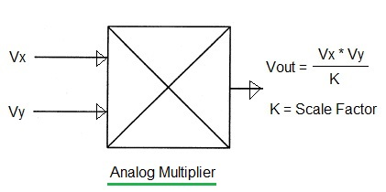
Analog Multipliers
Types:
Logarithmic Summing Technique (One Quadrant Device)
Pulse Height/Width Modulation Technique (One Quadrant Device)
Emitter Coupled Transistor Pair (Two Quadrant Device)
Gilbert Cell (Four Quadrant Device)
Variable Trans-conductance Technique
Symbol:

Slide 3

Analog Multipliers
Introduction:
A multiple produces an output V₀ which is proportional to the product of two inputs V_{x} and V_{y}. V₀ = KV_{x}V_{y} where K is the scaling factor = (1/10) V⁻¹.
An actual multiplier has its output voltage V₀ defined by,
where φx and φy are the offsets associated with signals Vx and Vy, ε is the error signal associated with K and φ0 is the offset voltage of the multiplier output.

Slide 4
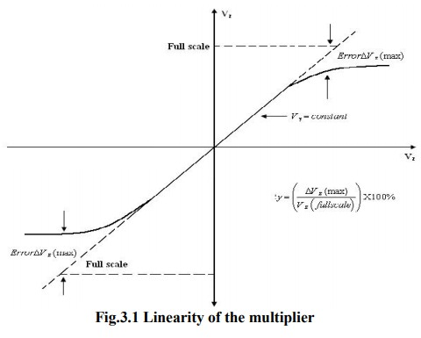
Analog Multipliers
Terminologies associated voltage of the multiplier characteristics:
Accuracy:
This specifies the derivation of the actual output from the ideal output, for any combination of X and Y inputs falling within the permissible operating range of the multiplier.
Linearity:
This defines the accuracy of the multiplier. The Linearity Error can be defined as the maximum absolute derivation of the error surface. This linearity error imposes a lower limit on the multiplier accuracy.
The figure shows the response of the output as a function of one input voltage V_{x} when the other V_{y} is assumed constant.
It represents the maximum percentage derivation from the ideal straight line output.
An error surface is formed by plotting the output for different combinations of X and Y inputs.

Slide 5
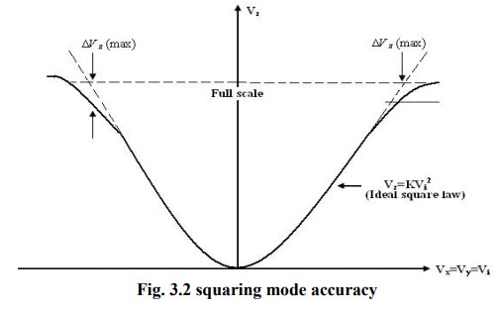
Analog Multipliers
Terminologies associated voltage of the multiplier characteristics:
Square law accuracy:
The Square – law curve is obtained with the X and Y inputs connected together and applied with the same input signal. The maximum derivation of the output voltage from an ideal square –law curve expresses the squaring mode accuracy.
Bandwidth:
The Bandwidth indicates the operating capability of an analog multiplier at higher frequency values. Small signal 3 dB bandwidth defines the frequency f0 at which the output reduces by 3dB from its low frequency value for a constant input voltage. This is identified individually for the X and Y input channels normally.
Bandwidth:
The quadrant defines the applicability of the circuit for bipolar signals at its inputs. First – quadrant device accepts only positive input signals, the two quadrant device accepts one bipolar signal and one unipolar signal and the four quadrant device accepts two bipolar signals.

Slide 6
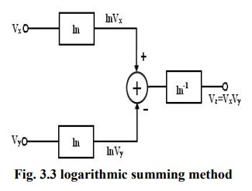
Analog Multipliers
Logarithmic summing Technique:
This technique uses the relationship
ln V_{x} + lnV_{y} =ln(V_{x}V_{y})
As shown in figure the input voltages V_{x} and V_{y} are converted to their logarithmic equivalent, which are then added together by a summer.
An antilogarithmic converter produces the output voltage of the summer. The output is given by,
V_{z} = ln⁻¹(ln(V_{x} V_{y} )) = V_{x} V_{y} .
The relationship between I₀ and V_{BE} of the transistor is given by I_{C} = I₀e^{(VBE /VT ) .}It is found that the transistor follows the relationship very accurately in the range of 10nA to 100mA. Logarithmic multiplier has low accuracy and high temperature instability.
This method is applicable only to positive values of V_{x} and V_{y}.
Limitation: This type of multiplier is restricted to one quadrant operation only.

Slide 7
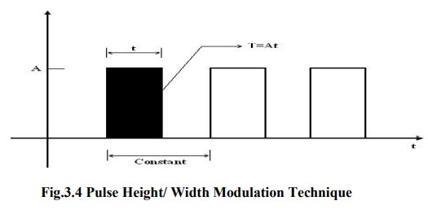

Analog Multipliers
Pulse Height/ Width Modulation Technique:
In this method, the pulse width of a pulse train is made proportional to one input voltage and the pulse amplitude is made proportional to the second input voltage.
Therefore,
V_{x} =K_{x} A, V_{y} =K_{y} t, and V_{z} =K_{z}T where K_{x}, K_{y}, K_{z} are scaling factors. In figure A is the amplitude of the pulse, t is the pulse width and T is the area of the pulse. Therefore,
The modulated pulse train is passed through an integrated circuit.
Therefore, the output of the integrator is proportional to the area of pulse, which in turn is proportional to the product of two input voltages.

Slide 8
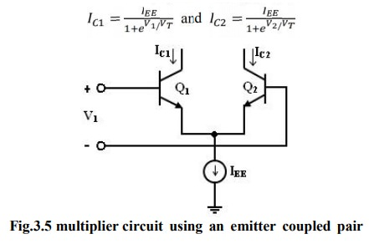
Analog Multipliers
Emitter coupled Transistor pair:
The output currents IC₁ and IC₂ are related to the differential input voltage V₁ by
where V_{T} is thermal voltage and the base currents have been neglected.

Slide 9
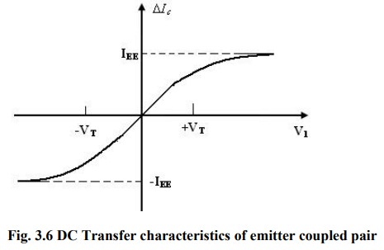
Analog Multipliers
Emitter coupled Transistor pair:
Combining above eqn., difference between the two output currents as,
The emitter coupled pair can be used as a simple multiplier using this configuration. When the differential input voltage V₁ << V_{T}, we can appropriate as given by,
∆I_{C} =I_{EE} ( V₁/2V_{T})
The current I_{EE} is the bias current for the emitter – coupled pair. If the current I_{EE} is made proportional to a second input signal V₂, then
I_{EE} =K₀ (V₂ – V_{BE(ON)})
Substituting above eqn. , we get
∆I_{C} = K₀V₁ (V₂ – V_{BE(ON)})/2V_{T}

Slide 10
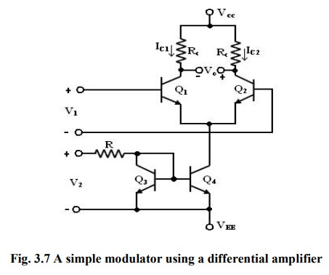
Analog Multipliers
Emitter coupled Transistor pair:
It is a simple modulator circuit constructed using a differential amplifier.
It can be used as a multiplier, provided V₁ is small and much less than 50mV and V₂ is greater than V_{BE} (on).
But, the multiplier circuit shown in figure has several limitations.
The first limitation is that V₂ is offset by V_{BE} (on).
The second is that V₂ must always be positive which results in only a two-quadrant multiplier operation.
The third limitation is that, the tanh (X) is approximately as X, where X = V₁/2V_{T}. The first two limitations are overcome in the Gilbert cell.

Slide 11
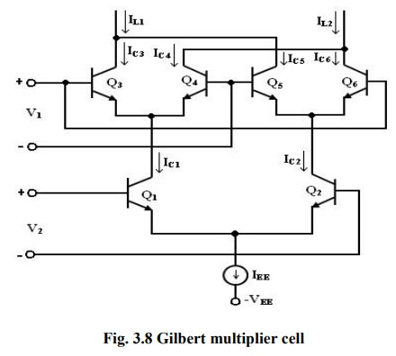
Analog Multipliers
Gilbert Multiplier cell:

Slide 12


Analog Multipliers
Gilbert Multiplier cell:
The Gilbert multiplier cell is a modification of the emitter coupled cell and this allows four – quadrant multiplication. Therefore, it forms the basis of most of the integrated circuit balanced Multipliers.
Two cross- coupled emitter- coupled pairs in series connection with an emitter coupled pair form the structure of the Gilbert multiplier cell.
The collector current of Q₃ and Q₄ are given by
Similarly, the collector current of Q₅ and Q₆ are given by

Slide 13



Analog Multipliers
Gilbert Multiplier cell:
Collector current I_{C1} and I_{C2} of transistors Q₁ and Q₂ can be expressed as
Substituting the above equation in I_{C3} and I_{C4}, we get
Similarly substituting I_{c2} in I_{c5} and I_{C6} , we get,

Slide 14
Analog Multipliers
Gilbert Multiplier cell:
The differential output current I is given by
∆I =I_{L1} - I_{L2}
= (I_{C3} +I_{C5}) - ( I_{C4}+I_{C6})
= (I_{C3} - I_{C6})-(I_{C4} - I_{C5})
∆I = I_{EE} tanh( V₁/2V_{T}) tanh(V₂/2V_{T})

Slide 15
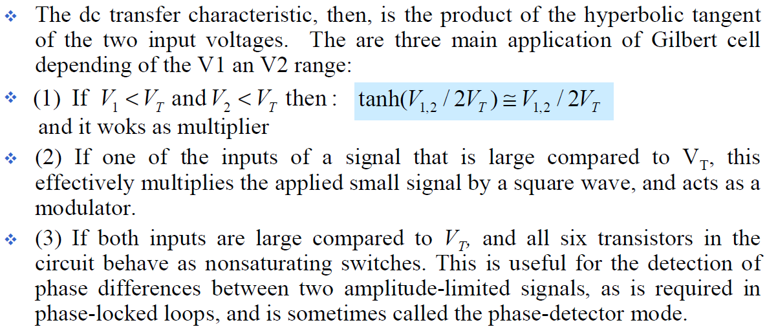
Analog Multipliers
Gilbert Multiplier cell:

Slide 16
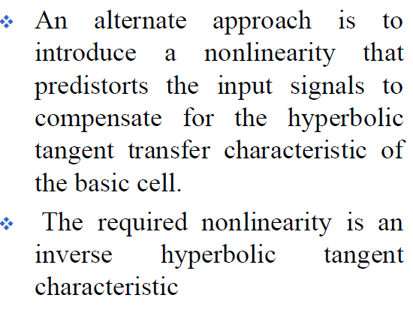
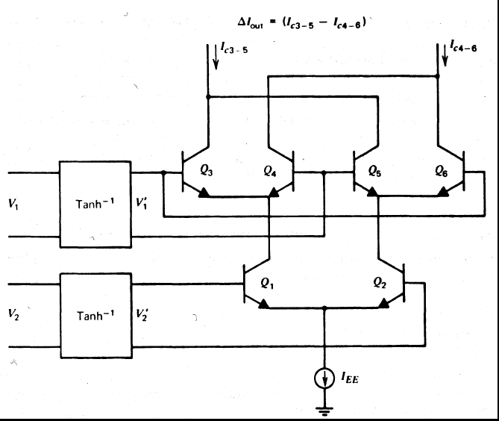
Analog Multipliers
Gilbert Multiplier cell :- Pre-Distortion Circuit:

Slide 17
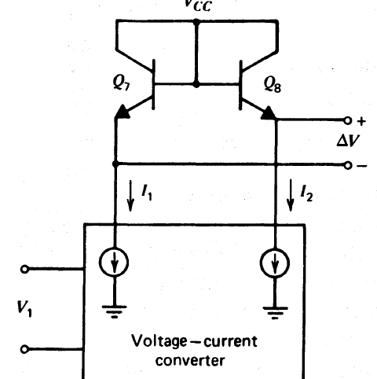
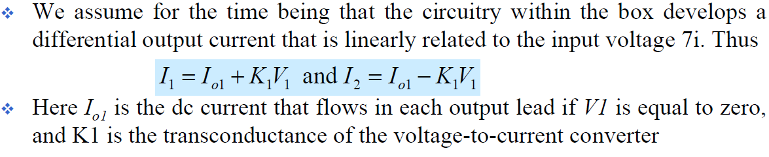
Analog Multipliers
Gilbert Multiplier cell :- Pre-Distortion Circuit:

Slide 18
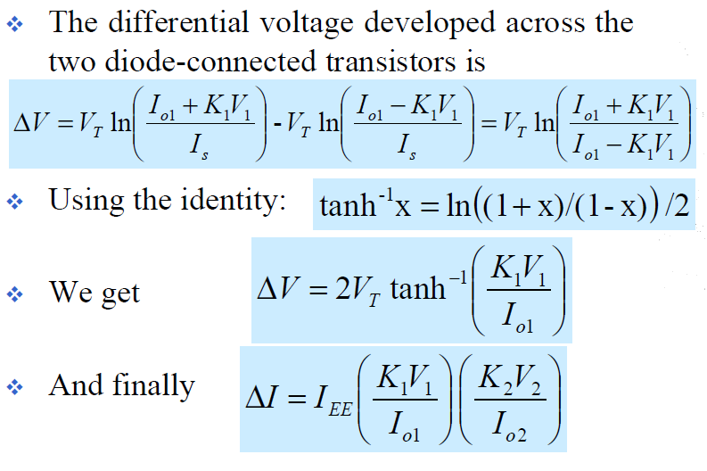
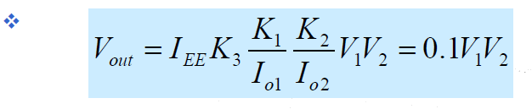
Analog Multipliers
Gilbert Multiplier cell :- Pre-Distortion Circuit:

Slide 19
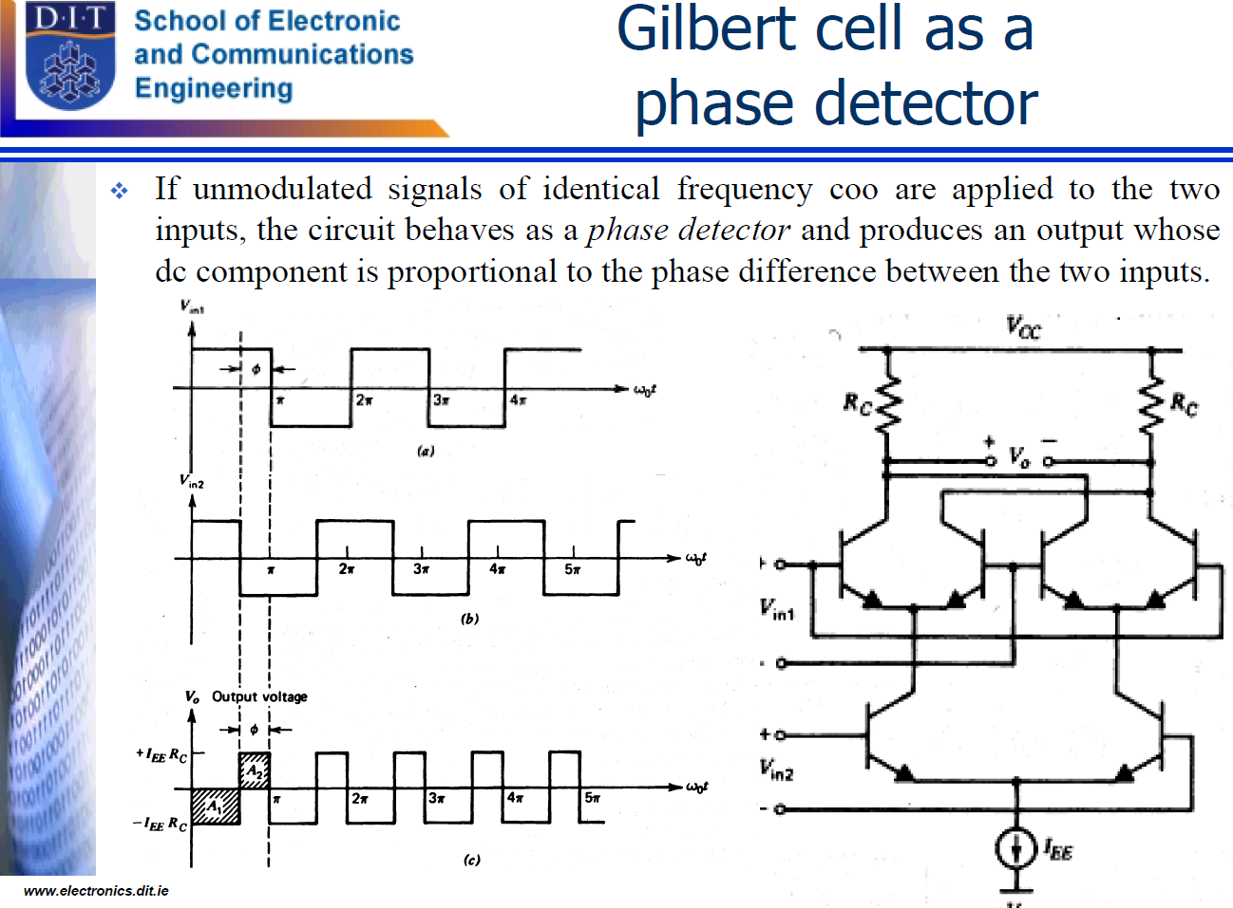

Slide 20
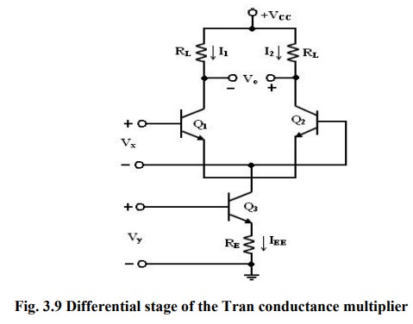
Analog Multipliers
Variable Transconductance Technique:

Slide 21
Analog Multipliers
Variable Transconductance Technique:
The variable transconductance technique makes use of the dependence characteristic of the transistor transconductance parameter on the emitter current bias applied. A simple differential circuit arrangement depicting the principle is shown in figure.
The relationship between V₀ and V_{x} . is given by V₀ = gm R_{L} V_{X} where gm = I_{EE} /V_{T} is the transconductance of the stage.
Application of a second input V_{y} to the reference current source of the differential amplifier can vary g_{m}.
Thus, if R_{E} I_{EE} >>V_{BE}, the bias voltage Vy is related to I_{EE} by the relation V_{y} = I_{EE} R_{E}.

Slide 22
Analog Multipliers
Variable Transconductance Technique:
Then, the overall voltage transfer expression is given by
V₀ = g_{m} R_{L}V_{x} = (V_{y}/V_{T}R_{E})V_{x}R_{L}
= V_{x}V_{y} RL/ V_{T}R_{E}

Slide 23
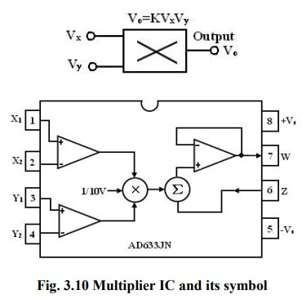
Analog Multipliers
Analog Multiplier ICs:
Analog multiplier is a circuit whose output voltage at any instant is proportional to the product of instantaneous value of two individual input voltages.
Important applications of these multipliers are multiplication, division, squaring and square – rooting of signals, modulation and demodulation.
AD633

Slide 24
Analog Multipliers
Analog Multiplier ICs:
The AD633 multiplier is a four – quadrant analog multiplier.
It possesses high input impedance; this characteristic makes the loading effect on the signal source negligible.
It can operate with supply voltages ranging from ±18V.
IC does not require external components.
The typical range of the two input signals is ±10V.
The schematic representation of an analog multiplier is shown in figure. The output V₀ is the product of the two inputs V_{x} and V_{y} is divided by a reference voltage V_{ref}.
Normally, the reference voltage V_{ref} is internally set to 10V. Therefore, V0 =V_{x}V_{y}/10.
In other words, the basic input – output relationship can be defined by KV_{x} V_{y} when K = 1/10, a constant. Thus for peak input voltages of 10V, the peak magnitude of output voltage is 1/10 *10 *10 =10V.
Thus, it can be noted that, as long as V_{x} < 10V and V_{y} < 10V, the multiplier output will not saturate.

Slide 25
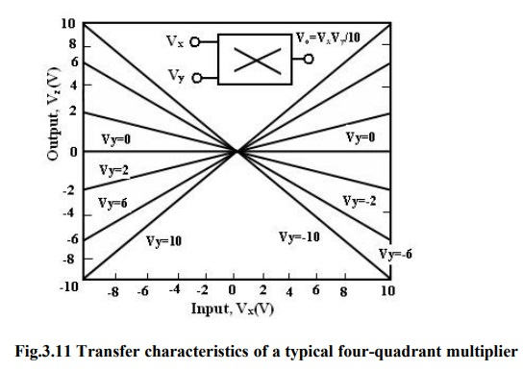
Analog Multipliers
Multiplier Quadrants:
Both the inputs can be positive or negative to obtain the corresponding output as shown in the transfer characteristics.
Applications of Multiplier ICs:
The multiplier ICs are used for the following purposes:
Voltage Squarer
Frequency doublers
Voltage divider
Square rooter
Phase angle detector
Rectifier

Slide 26
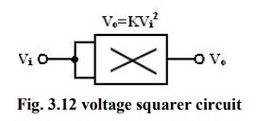
Analog Multipliers
Voltage Squarer:
Figure shows the multiplier IC connected as a squaring circuit. The inputs can be positive or negative, represented by any corresponding voltage level between 0 and 10V.
The input voltage V_{i} to be squared is simply connected to both the input terminals, and hence we have, V_{x} = V_{y} = V_{i} and the output is V0 = KV_{i}².
The circuit thus performs the squaring operation. This application can be extended for frequency doubling applications.

Slide 27
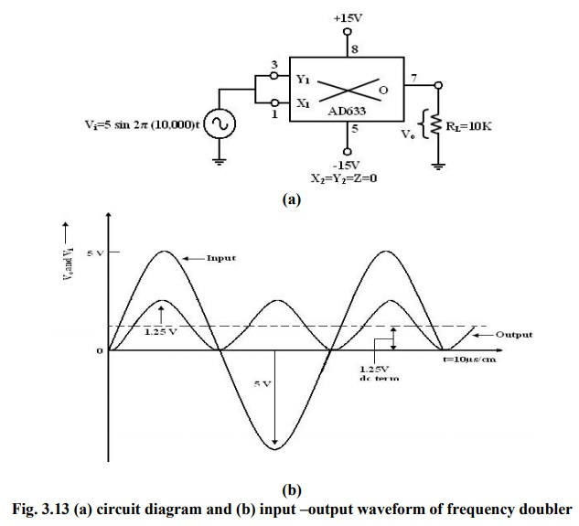
Analog Multipliers
Frequency doublers:

Slide 28

Analog Multipliers
Frequency doublers:
Figure shows the squaring circuit connected for frequency doubling operation. A sine-wave signal Vi has a peak amplitude of Av and frequency of f Hz. Then, the output voltage of the doublers circuit is given by
Assuming a peak amplitude Av of 5V and frequency f of 10KHz, V0 =1.25–1.25 cos2 20000) t. The first term represents the dc term of 1.25V peak amplitude.
The input and output waveforms are shown in figure. The output waveforms ripple with twice the input frequency in the rectified output of the input signal. This forms the principle of application of analog multiplier as rectifier of ac signals.
The dc component of output V₀ can be removed by connecting a 1µF coupling capacitor between the output terminal and a load resistor, across which the output can be observed.

Slide 29
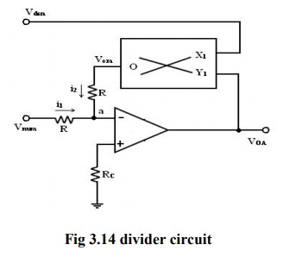
Analog Multipliers
Voltage Divider:
In voltage divider circuit the division is achieved by connecting the multiplier in the feedback loop of an op-amp.
The voltages V_{den} and V_{num} represent the two input voltages, Vdm forms one input of the multiplier, and output of op-amp VoA forms the second input.
The output V_{OA} forms the second input. The output VOM of the multiplier is connected back of op- amp in the feedback loop. Then the characteristic operation of the multiplier gives
V_{om} = KV_{OA} Vdm (1)

Slide 30
Analog Multipliers
Voltage Divider:
As shown in figure, no input signal current can flow into the inverting input terminal of op-amp, which is at virtual ground. Therefore, at the junction a, i₁ + i₂ =0, the current i1 = V_{num} / R, where R is the input resistance and the current i₂ = V_{om} /R. With virtual ground existing at a,
i₁+i₂ = V_{num} / R + V_{om} /R = 0
KV_{OA} V_{den} = - V_{num}
or
voA=- v_{num}/Kv_{den}
where V_{num} and V_{den} are the numerator and denominator voltages respectively.
Therefore, the voltage division operation is achieved. V_{num} can be a positive or negative voltage and V_{den} can have only positive values to ensure negative feedback.
When Vdm is changed, the gain 10/V_{dm} changes, and this feature is used in automatic gain control (AGC) circuits.

Slide 31
Analog Multipliers
Square Rooter:
The divider voltage can be used to find the square root of a signal by connecting both inputs of the multiplier to the output of the op-amp. Substituting equal in magnitude but opposite in polarity (with respect to ground) to Vi. But we know that Vom is one- term (Scale factor) of V0 * V0 or -V_{i} = V_{om} = V²/10
Solving for V₀ and eliminating √-1 yields. V₀ = √10|Vi |
Eqn. states that V₀ equals the square root of 10 times the absolute magnitude of V_{i}.
The input voltage Vi must be negative, or else, the op-amp saturates.
The range of Vi is between -1 and -10V. Voltages less than -1V will cause inaccuracies in the result.
The diode prevents negative saturation for positive polarity Vi signals. For positive values of Vi the diode connections are reversed.

Slide 32
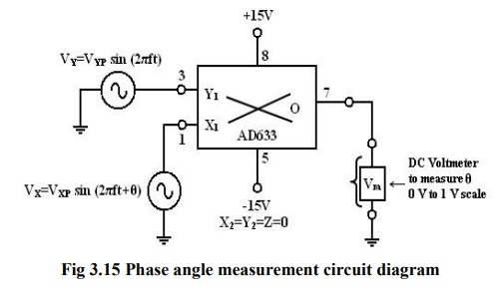
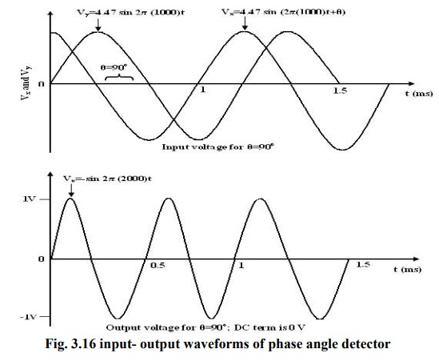
Analog Multipliers
Phase Angle detector:

Slide 33
Analog Multipliers
Phase Angle detector:
The multiplier configured for phase angle detection measurement is shown in figure. When two sine-waves of the same frequency are applied to the inputs of the multiplier, the output V0 has a dc component and an AC component.
The trigonometric identity shows that
Sin A sin B =1/2 (cos (A-B) – cos (A+B)).
When the two frequencies are equal, but with different phase angles, e.g. A=2πft +θ for signal Vx and B= 2πft for signal V_{y}, then using the identity
[sin (2πft+θ)][sin2πft)]=1/2[cosθ-cos(4πft+θ)]=1/2(dc- the double frequency term)

Slide 34

Analog Multipliers
Phase Angle detector:
Therefore, when the two input signals V_{x} and V_{y} are applied to the multiplier, V₀ (dc) is given by
where V_{xp} and V_{yp} are the peak voltage amplitudes of the signals V_{x} and V_{y}. Thus, the output V₀(dc) depends on the factor cos θ. A dc voltmeter can be calibrated as a phase angle meter when the product of V_{xp} and V_{yp} is made equal to 20. Then, a (0-1) V range dc voltmeter can directly read cos θ, with the meter calibrated directly in degrees from a cosine table. The input and output waveforms are shown in figure.
Then the above eqn becomes V₀ (dc) = cos θ, if we make the product V_{xp} V_{yp} = 20 or in other words, V_{xp} – V_{yp} = 4.47V.

Slide 35
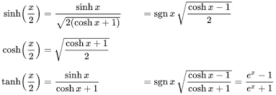
http://www.brainkart.com/article/Analog-Multipliers_36018/
GILBERT MULTIPLIER CELL | ANALOG MULTIPLIER USING EMITTER COUPLED TRANSISTOR PAIRS
https://www.youtube.com/watch?v=Bdng-6N00G8

